Slide 1
Graph of Straight Lines and Quadratic Functions
Mrs. Parami Wattetenne
Lecturer (Probationary)
Department of Multidisciplinary Studies
Faculty of Technology
University of Ruhuna

Slide 2
Topic Covered
Cartesian X-Y plane
Straight Line Equations
Graph of Straight Lines
Qudratic Functions
Graph of Qudratic Functions
Maximum and Minimum Values
System of Linear Equations

Slide 3
Cartesian X-Y plane
The Cartesian coodinate system consist of:
X axis – horizontal axis
Y axis – vertical axis
Origin - (0,0)
A point is represented by (x,y)

Slide 4
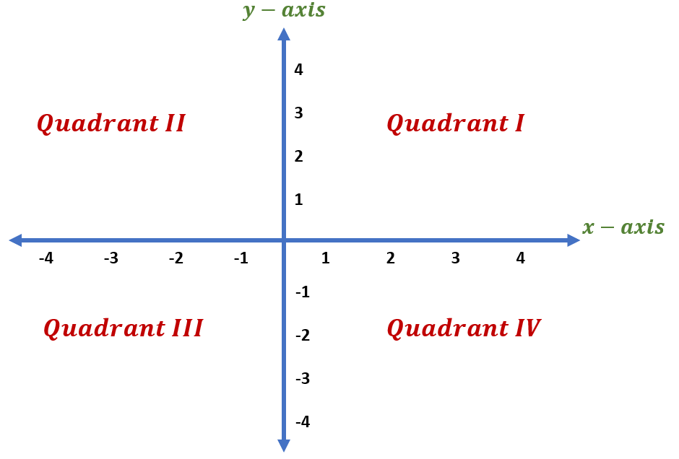
Cartesian X-Y plane
Four Qudrants:

Slide 5
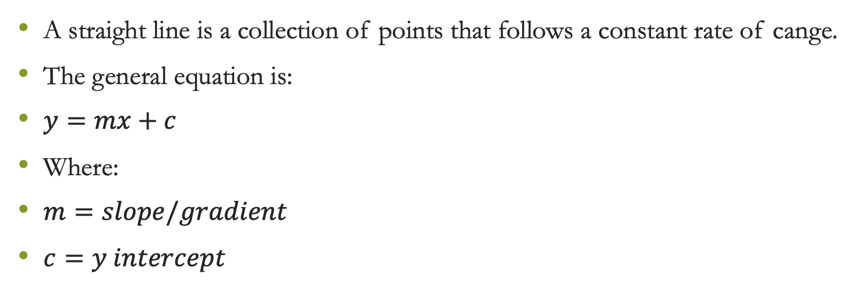
What is a Staright Line?
A straight line is a collection of points that follows a constant rate of cange.
The general equation is:
$y=mx+c$
Where:
$m=slope/gradient$
$c=y intercept$

Slide 6
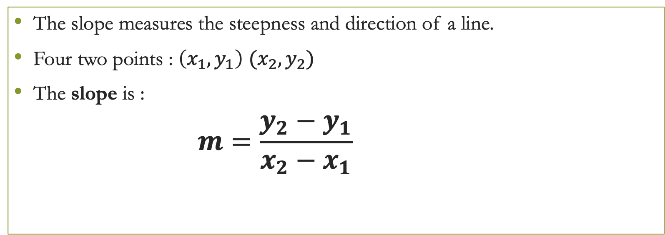
Slope of a Straight Line
The slope measures the steepness and direction of a line.
Four two points : $\left(x_{1},y_{1}\right)$ $(x_{2},y_{2})$
The slope is :
            $$m=\frac{y_{2}−y_{1}}{x_{2}−x_{1}}$$

Slide 7
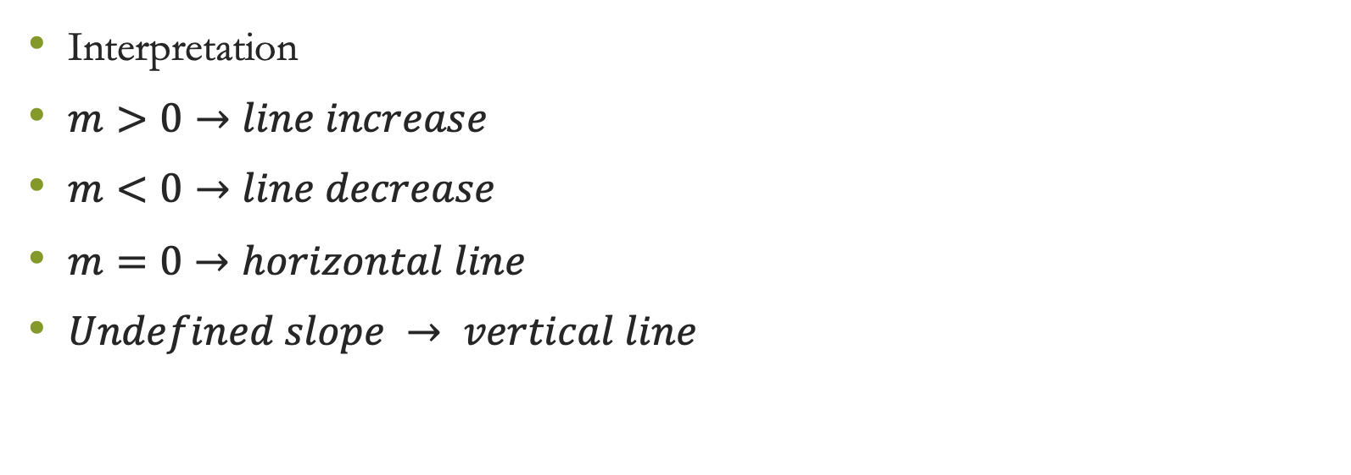
Slope of a Straight Line
Interpretation
$m>0→line increase$
$m<0→line decrease$
$m=0→horizontal line$
$Undefined slope → vertical line$

Slide 8
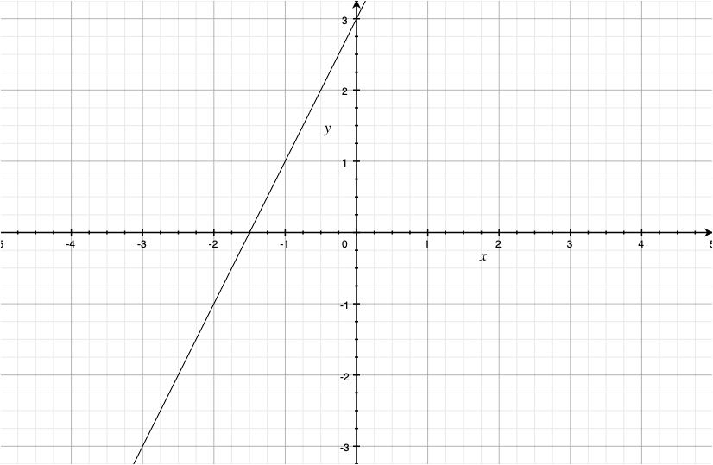
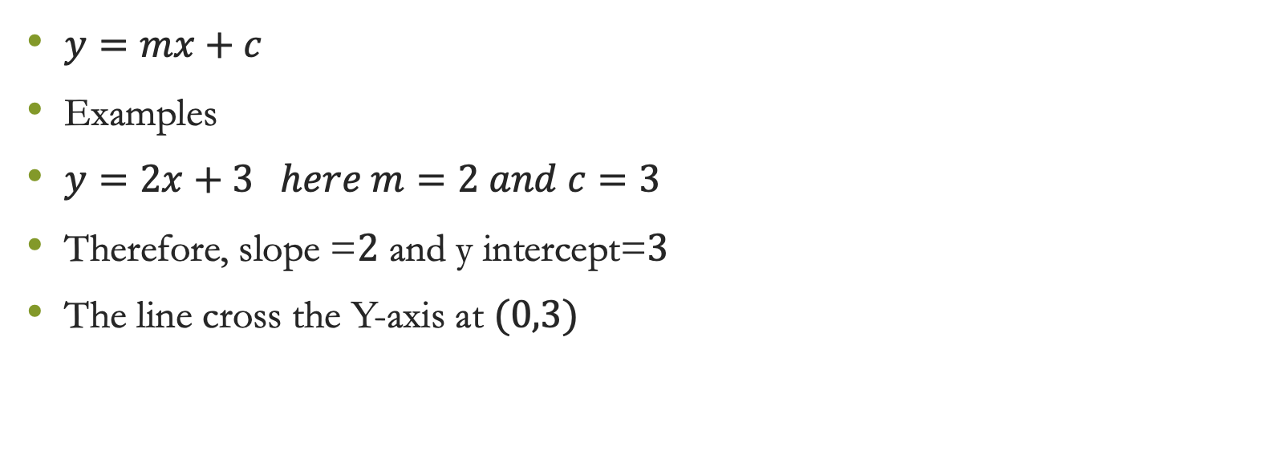
Equation of a Straight Line
$y=mx+c$
Examples
$y=2x+3 here m=2 and c=3$
Therefore, slope =$2$ and y intercept=$3$
The line cross the Y-axis at $(0,3)$

Slide 9
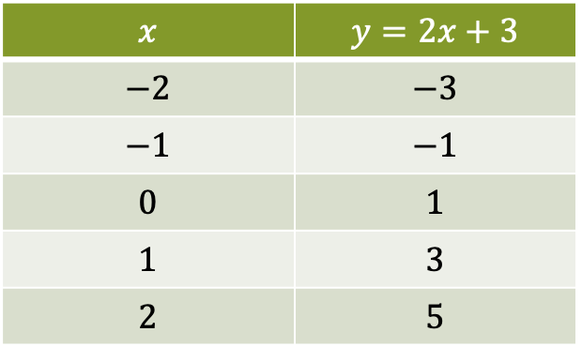
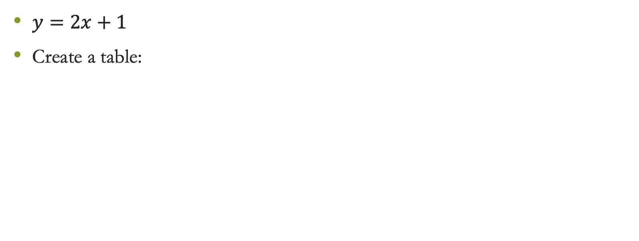
Drawig a Straight Line Graph
$y=2x+1$
Create a table:
$$x$$ | $$y=2x+3$$
$$−2$$ | $$−3$$
$$−1$$ | $$−1$$
$$0$$ | $$1$$
$$1$$ | $$3$$
$$2$$ | $$5$$

Slide 10
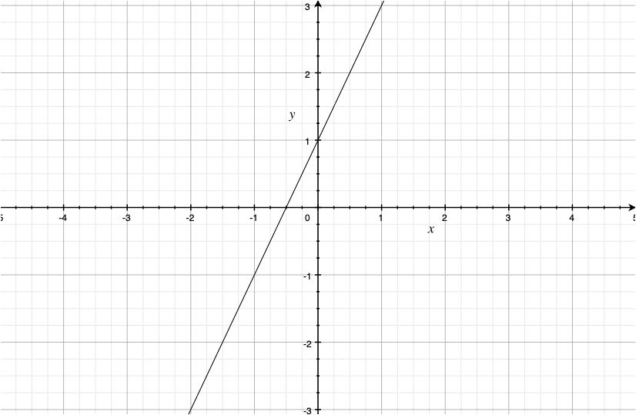
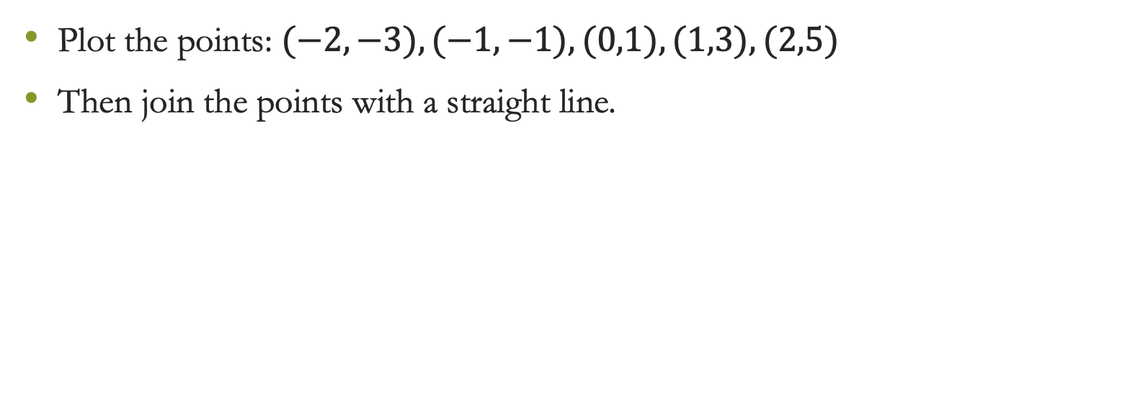
Drawig a Straight Line Graph
Plot the points: $(−2,−3),(−1,−1),(0,1),(1,3),(2,5)$
Then join the points with a straight line.

Slide 11
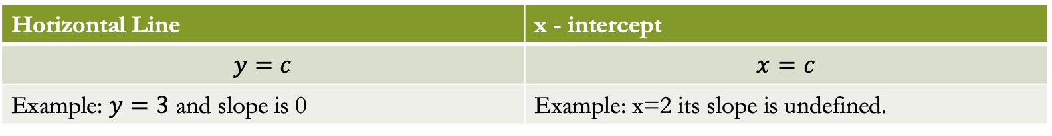
Special Straight Lines
Horizontal Line | x - intercept
$$y=c$$ | $$x=c$$
Example: $y=3$ and slope is 0 | Example: x=2 its slope is undefined.

Slide 12
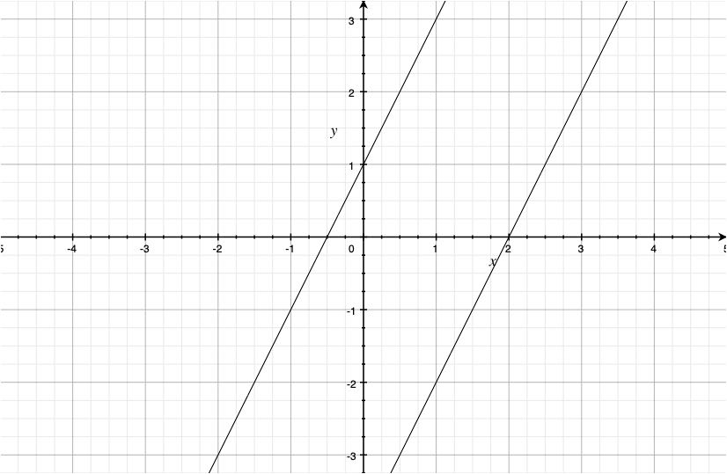
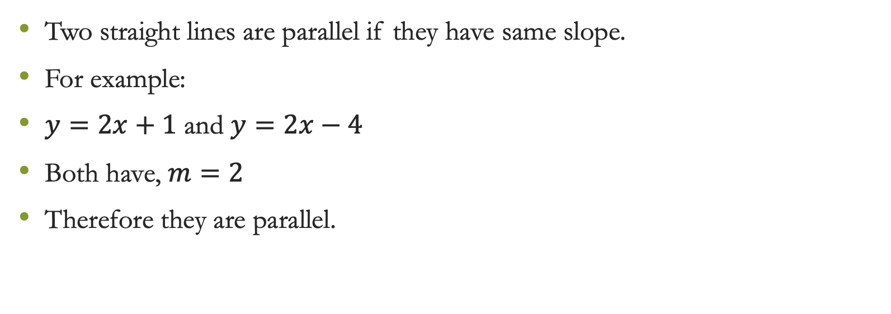
Parallel Lines
Two straight lines are parallel if they have same slope.
For example:
$y=2x+1$ and $y=2x−4$
Both have, $m=2$
Therefore they are parallel.

Slide 13
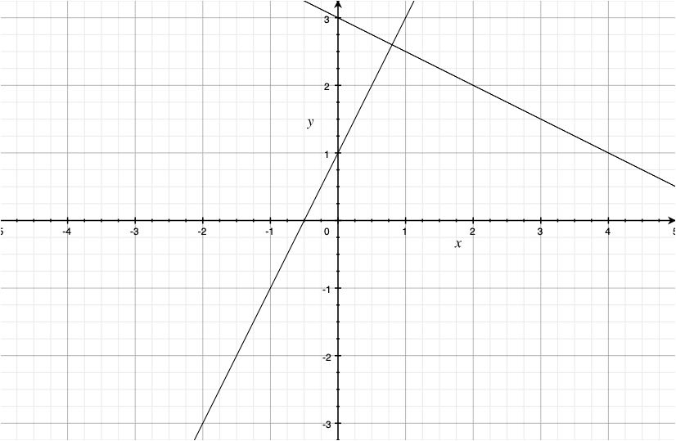
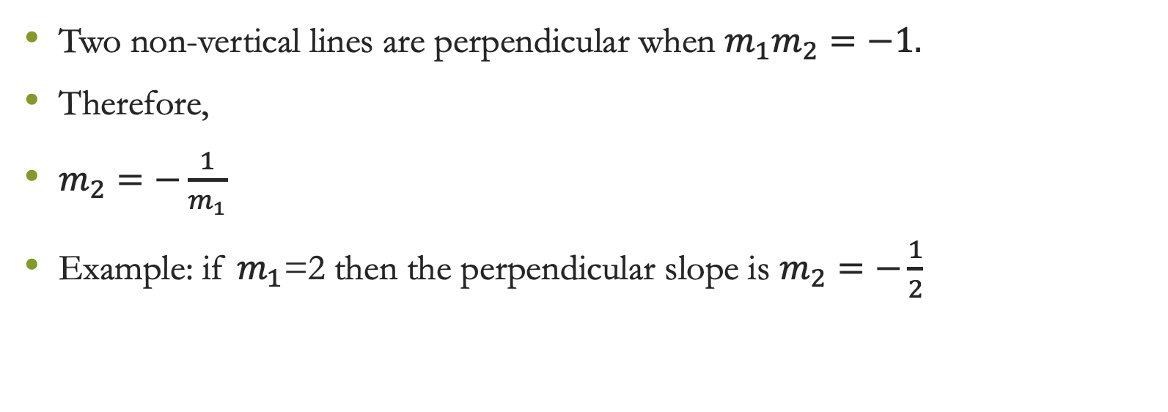
Perpendicular Lines
Two non-vertical lines are perpendicular when $m_{1}m_{2}=−1.$
Therefore,
$m_{2}=−\frac{1}{m_{1}}$
Example: if $m_{1}$=2 then the perpendicular slope is $m_{2}=−\frac{1}{2}$

Slide 14
Thank You

